Slide 1
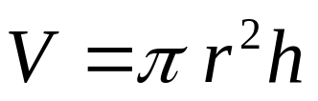
14.1 Functions of Several Variables
Many functions depend on more than one independent variable. For instance, the volume of a right circular cylinder is a function of its radius and its height, so it is a function V(r, h) of two variables r and h. In this chapter we extend the basic ideas of single variable calculus to functions of several variables. Their derivatives are more varied and interesting because of the different ways the variables can interact.

Slide 2
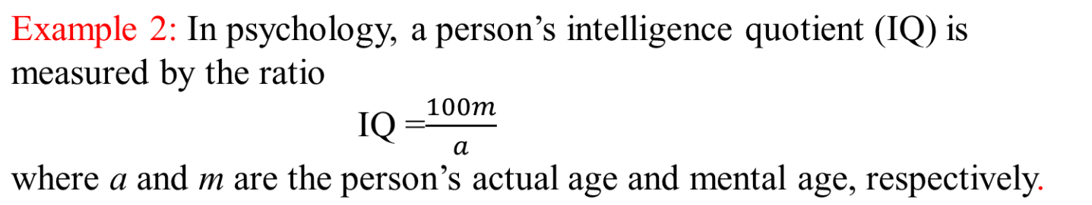
Example 1: In business, if a manufacturer determines that x units of a particular commodity can be sold domestically for $90 per unit, and y units can be sold to foreign markets for $110 per unit, then the total revenue obtained from all sales is given by
R=90x+110y

Slide 3
Example 3: A carpenter constructing a storage box x feet long, y feet wide, and z feet deep knows that the box will have volume V and surface area S, where
V=xyz and S=2xy +2xz+2yz

Slide 4
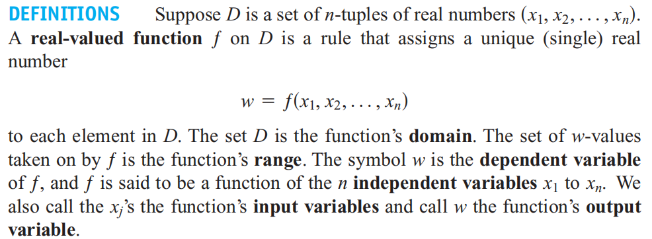
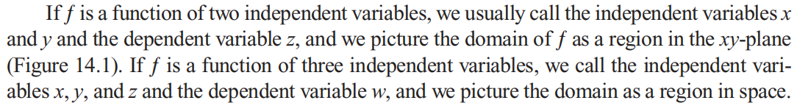

Slide 5
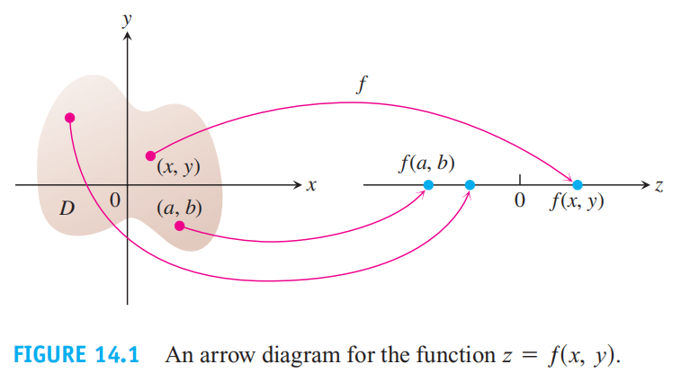
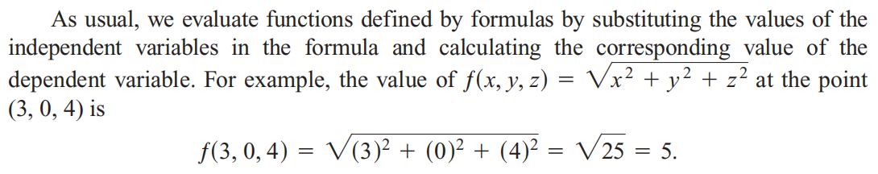

Slide 6
Domains and Ranges
In defining a function of more than one variable, we follow the usual practice of excluding inputs that lead to complex numbers or division by zero.The domain of a function is assumed to be the largest set for which the defining rule generates real numbers, unless the domain is otherwise specified explicitly (Domain Convention) . The range consists of the set of output values for the dependent variable.

Slide 7
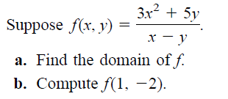
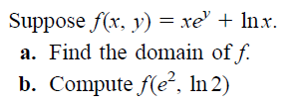
Example 4:
Example 5:

Slide 8
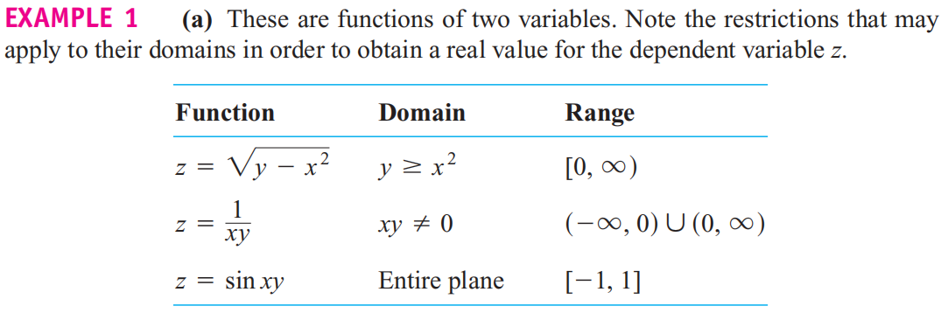
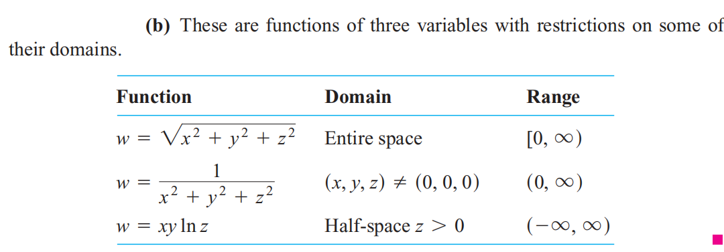

Slide 9
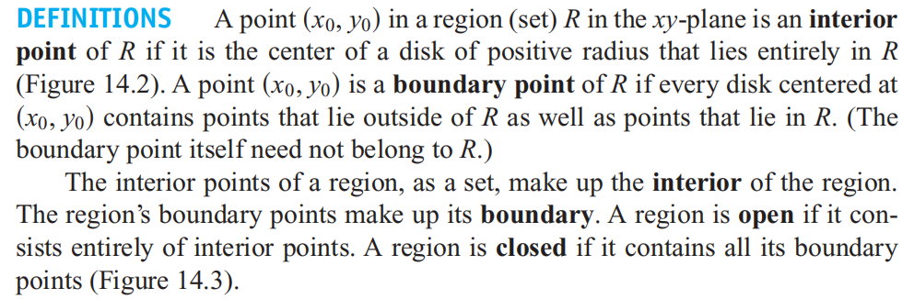
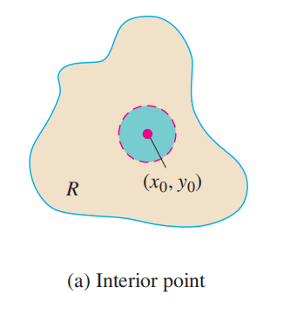
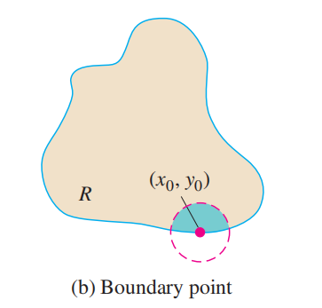
Functions of Two Variables

Slide 10
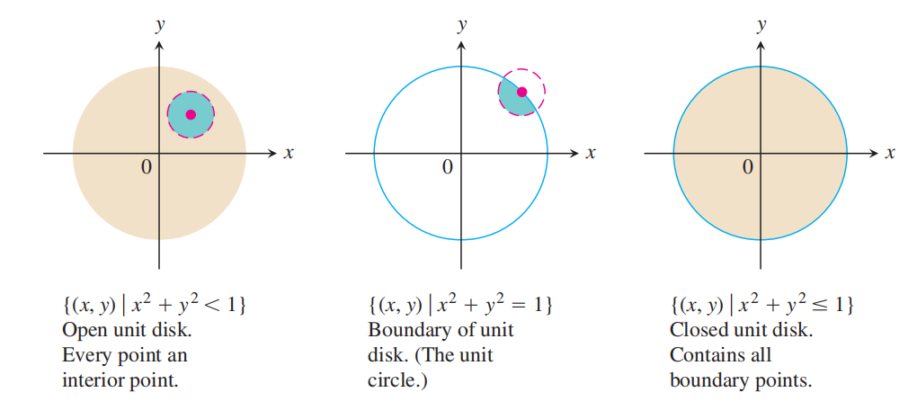

Slide 11
Examples of bounded sets in the plane include line segments, triangles, interiors of triangles, rectangles, circles, and disks. Examples of unbounded sets in the plane include lines, coordinate axes, the graphs of functions defined on infinite intervals, quadrants, half-planes, and the plane itself

Slide 12
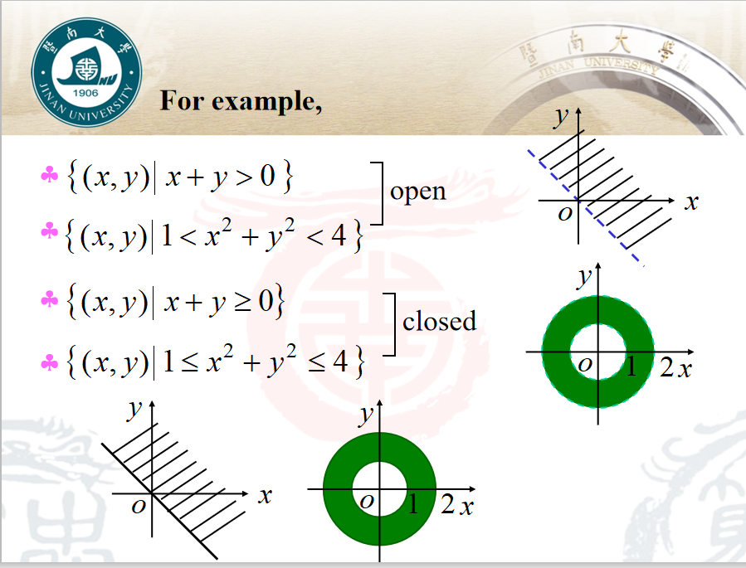

Slide 13
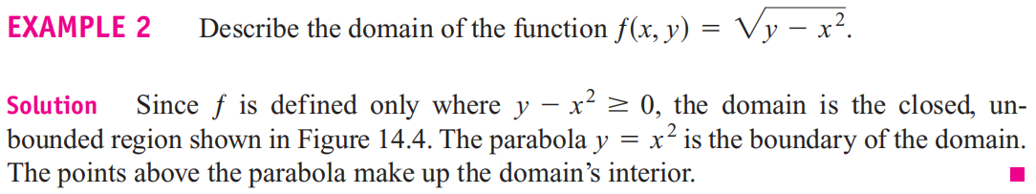
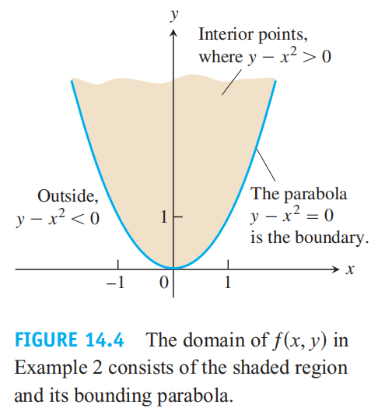

Slide 14
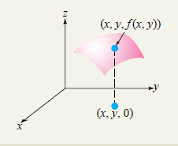
Graphs of Functions of Two Variables
The graph of a function of two variables f (x, y) is the set of all triples (x, y, z) such that (x, y) is in the domain of f and z=f (x, y).
To graph a function f (x, y) of the two independent variables x and y, it is customary to introduce the letter z to stand for the dependent variable and to write z=f (x, y) . The ordered pairs (x, y) in the domain of f are thought of as points in the xy plane, and the function f assigns a “height” z to each such point (“depth” if z is negative).

Slide 15
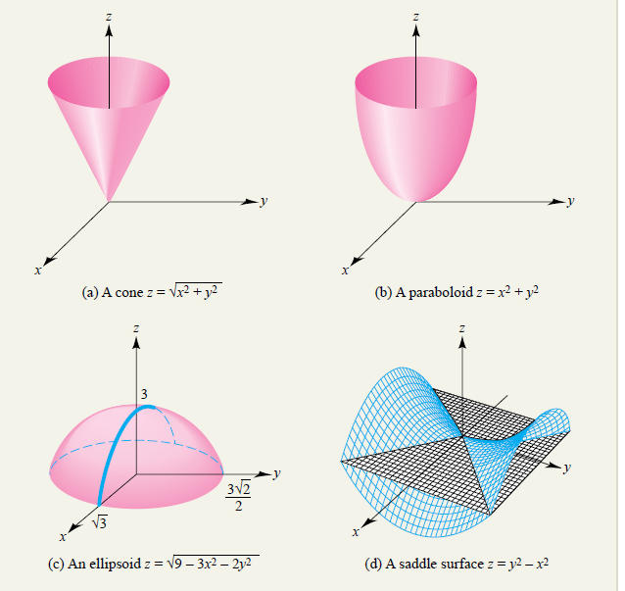

Slide 16
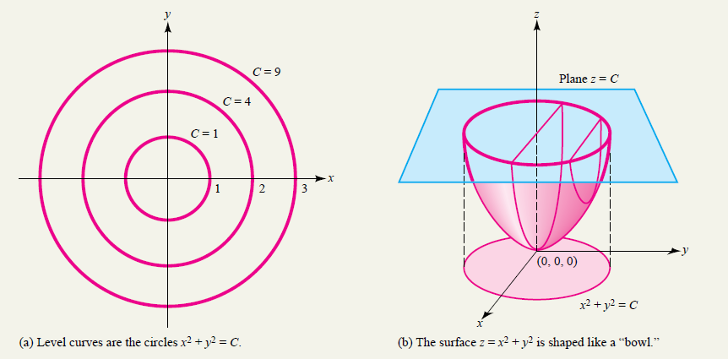
Level Curves
When the plane z=C intersects the surface z= f (x, y), the result is a curve in space. The corresponding set of points (x, y) in the xy plane that satisfy f (x, y)=C is called the level curve of f at C, and an entire family of level curves is generated as C varies over a set of numbers
Example :

Slide 17
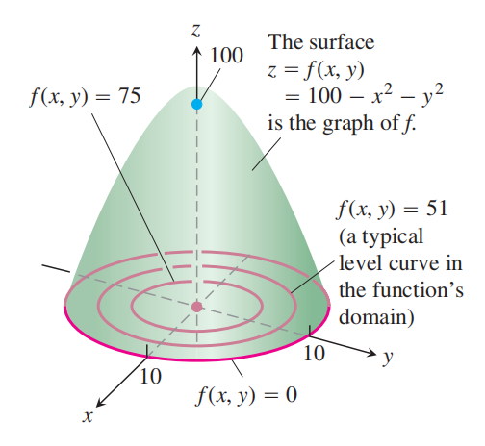

Slide 18
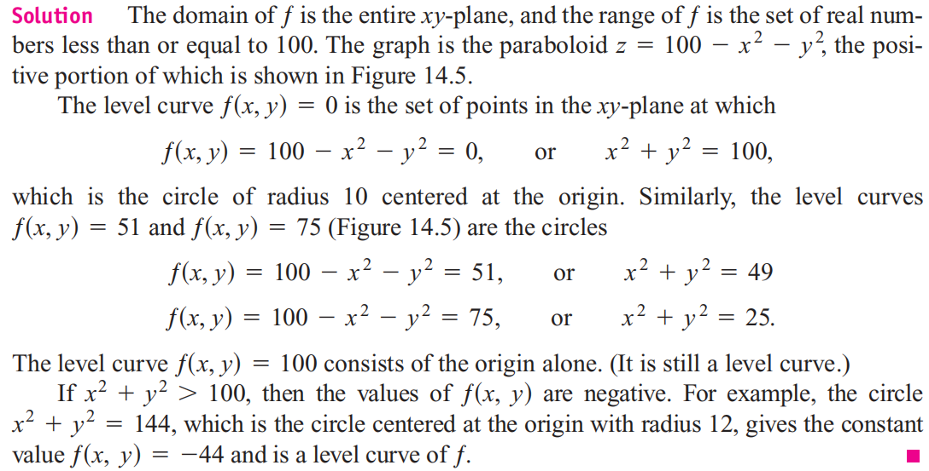

Slide 19
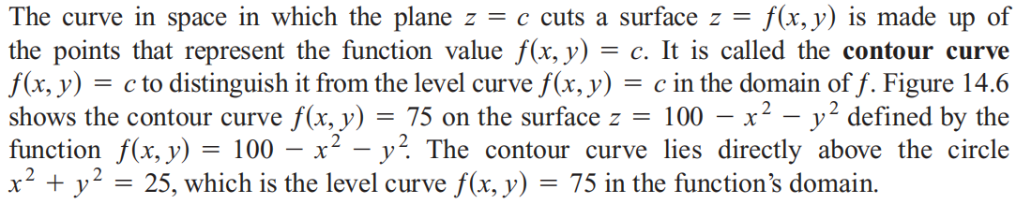
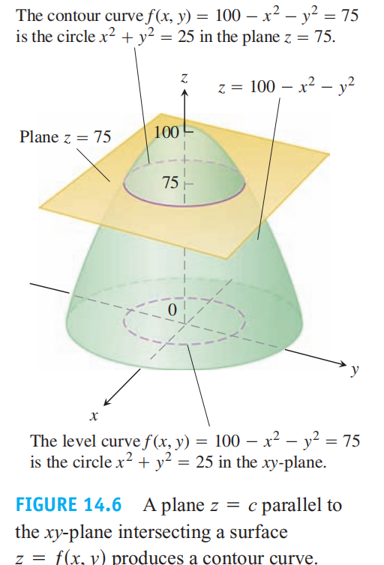

Slide 20
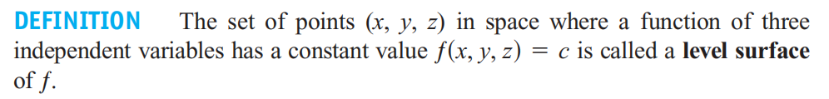
Functions of Three Variables
Since the graphs of functions of three variables consist of points (x, y, z, ƒ(x, y, z)) lying in a four-dimensional space, we cannot sketch them effectively in our three-dimensional frame of reference. We can see how the function behaves, however, by looking at its three dimensional level surfaces.

Slide 21
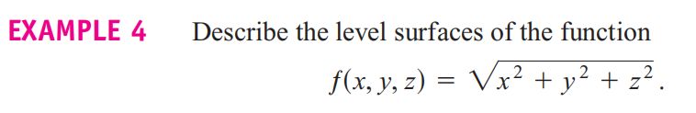
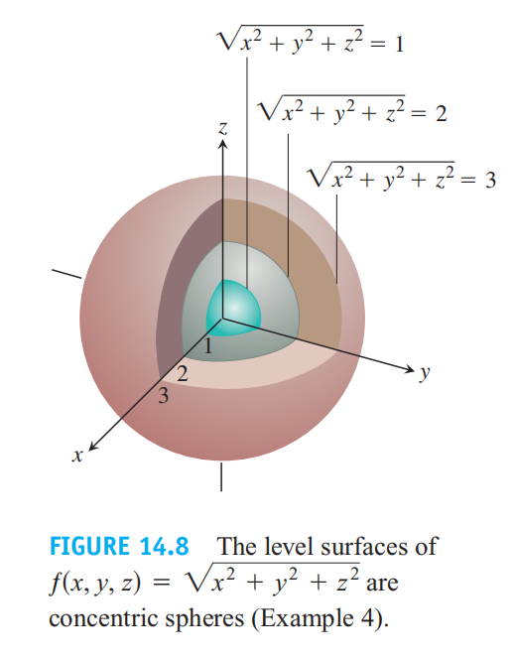

Slide 22
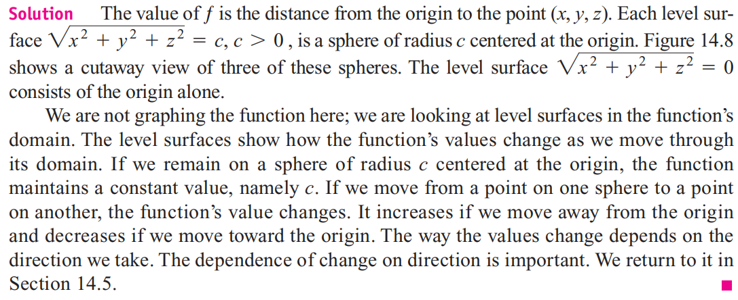

Slide 23
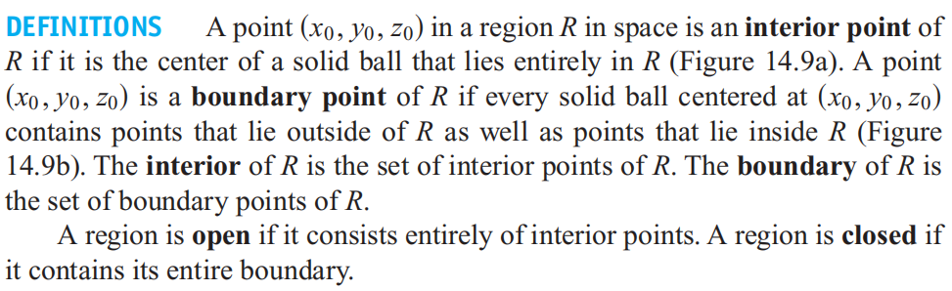
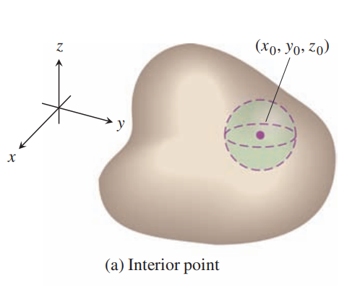
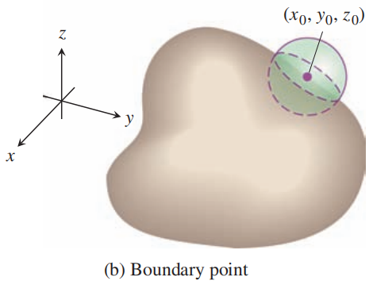

Slide 24
Examples of open sets in space include the interior of a sphere, the open half-space z > 0, the first octant (where x, y, and z are all positive), and space itself.
Examples of closed sets in space include lines, planes, and the closed half-space z ≥ 0.
A solid sphere with part of its boundary removed or a solid cube with a missing face, edge, or corner point is neither open nor closed.

